Slide 1
Data Analytics
What do we do with missing data?

Slide 2
Missing data for Trees
Delete cases
Prior to analysis use imputation
Send all cases with missing values with the majority of that node
Allow missing to be value of variable
Easy for categorical.
What happens with quantitative?
Assign cases to go left or right probabilistically using p_{R} and p_{L}
Use Surrogates

Slide 3
Surrogates
Surrogate – a variable with possibly equivalent information
A surrogates is a splitter that splits in a fashion similar to the primary splitter
Reveals structure of the info in the variables at a particular node in the tree
Use surrogate split if data is missing
If the primary is expensive or difficult to gather – use surrogate instead

Slide 4
Surrogate
Cases with data for both splits
For any node t primary splitter s sends t_{l} cases to left and t_{r} right
For any other split s* of the node t into t_{l}* and t*_{r}
N_{j}(LL) no. of cases in t that both s and s* send left for class j
N_{j}(RR) no. of cases in t that both s and s* send right for class j

Slide 6
What is a perfect splitter?
Same cases – not just similar numbers
We need to calculate the probability that both splitters s and s* send cases in the same direction.
Call this p(s,s*)

Slide 7
Example

Slide 8
Class 1
 |  | PRIMARY
 |  | LEFT | Rt.
Surr. | LEFT | 400 | 50 | 450
 | Right | 100 | 50 | 150
 |  | 500 | 100

Slide 9
Class 2
 |  | Primary
 |  | Left | RT.
Surr. | Left | 100 | 50 | 150
 | Right | 0 | 250 | 250
 |  | 100 | 300 | 400

Slide 10
How a good a predictor is s*?
How well can another split s* mimic the primary splitter s?
How high is p(s,s*)?
We need to compare the rule to something
Comparison or Default Rule
For node t suppose that s sends cases with prob. p_{l} and right with prob. p_{r. (}relative)
New case – predict t_{l} if p_{l}=max(p_{l},p_{r}) else t_{r}
r(t) (misclassification rate)=min(p_{l},p_{r})

Slide 11
Example

Slide 12
What happens in the example?
Using the data for our priors we can compute these directly from the tree
pl=0.6 pr=0.4
Default rule = Send everything to the left
Error = 1-0.6 = 0.4
Compare this to the surrogate rule

Slide 13
Surrogate rule
p(s,s*)=0.8
Called agreement in R
You can go through the calculations yourself on Blackboard
Error rate = 0.2

Slide 14
Association
Relative reduction in error obtained by using s* to predict s instead of max (p_{l},p_{r}) called adj in R

Slide 15
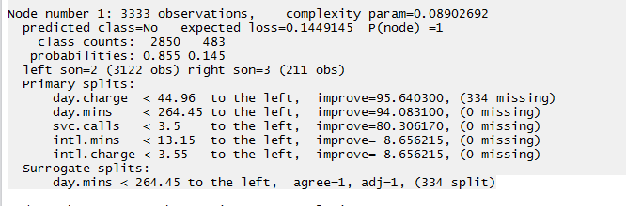
R output

Slide 16
General Comments
Surrogates are node dependent- calculated at the local level
Surrogates versus primary splits
Useful for examining what node is trying to do?
Can choose how many you calculate at each node

Slide 17
Variable Importance
Assess the relative importance of the variables in a tree
Measured by impurity improvement
Looks at primary splitter for each node and all the surrogate splits listed on rpart for every node.
Can control the number of surrogates
Calculated over tree

Slide 18
Variable Importance
You can print out the actual value for Variable Importance for each variable
fit = rpart (etc )
fit is an S3 object
Use str(fit) to see what it contains
fit$variable.importance
Calculates as a %

Slide 19
Calculation of p(s,s*)
The following slides show how to calculate p(s,s*) for the above example.

Slide 20
For this example : j=2
NN1L= 500 NN2L= 100
NN* 1L=450 NN* 2L=150
NN1R= 100 NN2R= 300
NN* 1R=150 NN* 2R=250
NN1(LL)=400 NN2(LL)=100
NN1(RR)= 50 NN2(RR)=250

Slide 21
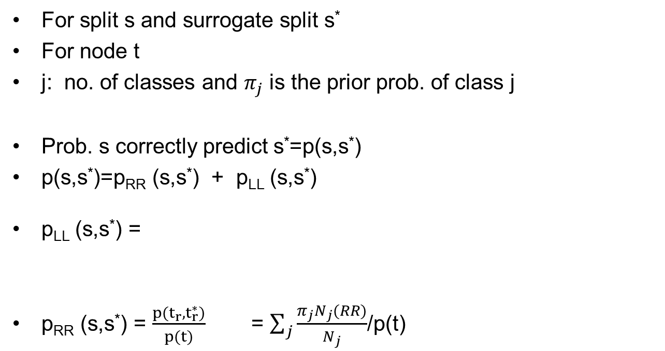
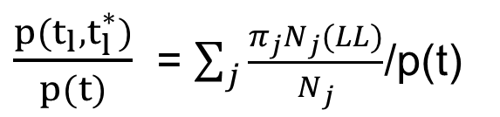
Calculating similarity
For split s and surrogate split s*
For node t
j: no. of classes and $π_{j}$ is the prior prob. of class j
Prob. s correctly predict s*=p(s,s*)
p(s,s*)=p_{RR} (s,s*) + p_{LL} (s,s*)
p_{LL} (s,s*) =
p_{RR} (s,s*) = $\frac{p(t_{r},t_{r}^{∗})}{p(t)}$ = $\sum_{j}{\frac{π_{j}N_{j}(RR)}{N_{j}}}$/p(t)
$\frac{p(t_{l},t_{l}^{∗})}{p(t)}$ = $\sum_{j}{\frac{π_{j}N_{j}(LL)}{N_{j}}}$/p(t)

Slide 23
Priors from data

Slide 24
Class 1
 |  | PRIMARY
 |  | LEFT | Rt.
Surr. | LEFT | 400 | 50 | 450
 | Right | 100 | 50 | 150
 |  | 500 | 100

Slide 25
Class 2
 |  | Primary
 |  | Left | RT.
Surr. | Left | 100 | 50 | 150
 | Right | 0 | 250 | 250
 |  | 100 | 300 | 400

Slide 26
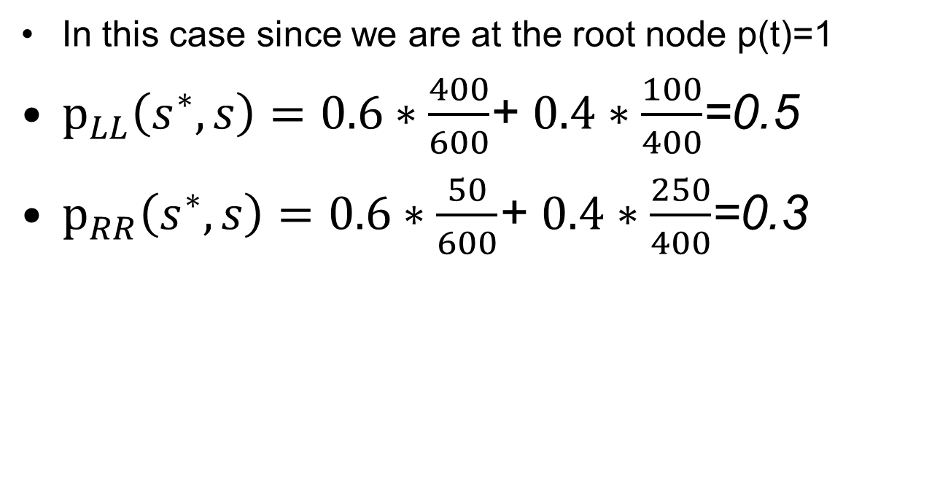
Continuing ….
In this case since we are at the root node p(t)=1
${\text{p}}_{LL}\left(s^{∗},s\right)=0.6∗\frac{400}{600}$+ $0.4∗\frac{100}{400}$=0.5
${\text{p}}_{RR}\left(s^{∗},s\right)=0.6∗\frac{50}{600}$+ $0.4∗\frac{250}{400}$=0.3
Error = 1-.0.8 = 0.2

Slide 27
A little clarification
Calculating pl and pr

Slide 28
Priors from data
For any split choose the highest value of

Slide 29
When can we just add the numbers?

